Slide 1
Negative Training for Neural Dialogue Response Generation
ACL 2020
He and Glass

Slide 2
Outline
Introduction
Motivation
Method
Experiment
Conclusion

Slide 3
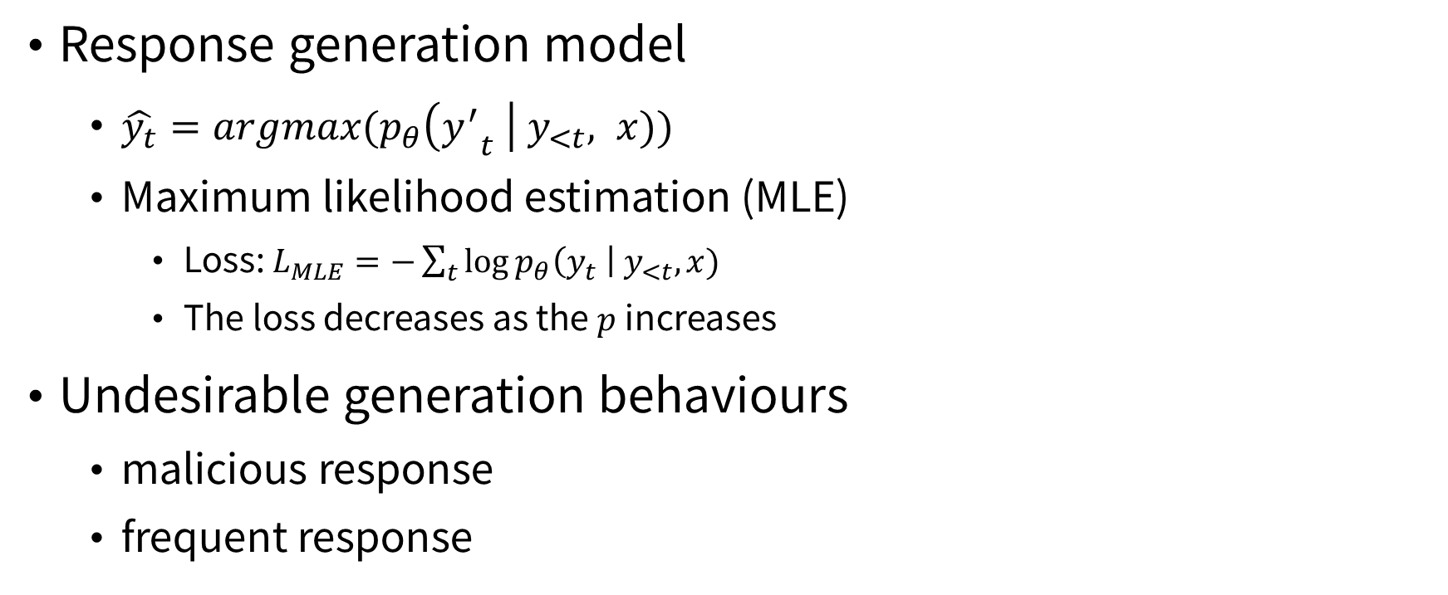
Introduction
Back to Outline
Response generation model
$\hat{y_{t}}=argmax(p_{θ}\left({y^{′}}_{t} \right| y_{<t}, x))$
Maximum likelihood estimation (MLE)
Loss: $L_{MLE}=−\sum_{t}{\log{p_{θ}\left(y_{t} \right| y_{<t},x)}}$
The loss decreases as the $p$ increases
Undesirable generation behaviours
malicious response
frequent response

Slide 4
Motivation
Back to Outline
Undesirable generation behaviours
malicious response
frequent response
The intuition is that the model should not assign larger probabilities to the malicious sentences than the reference sentences in the test set.

Slide 5
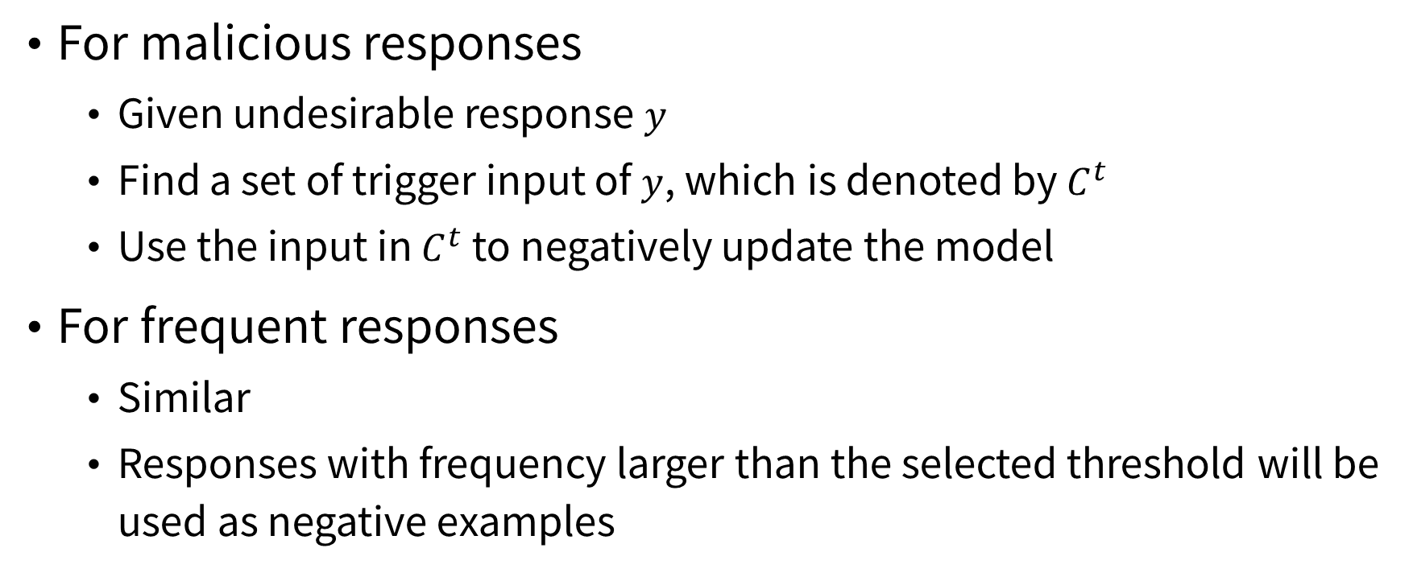
Method
Back to Outline
For malicious responses
Given undesirable response $y$
Find a set of trigger input of $y$, which is denoted by $C^{t}$
Use the input in $C^{t}$ to negatively update the model
For frequent responses
Similar
Responses with frequency larger than the selected threshold will be used as negative examples

Slide 6
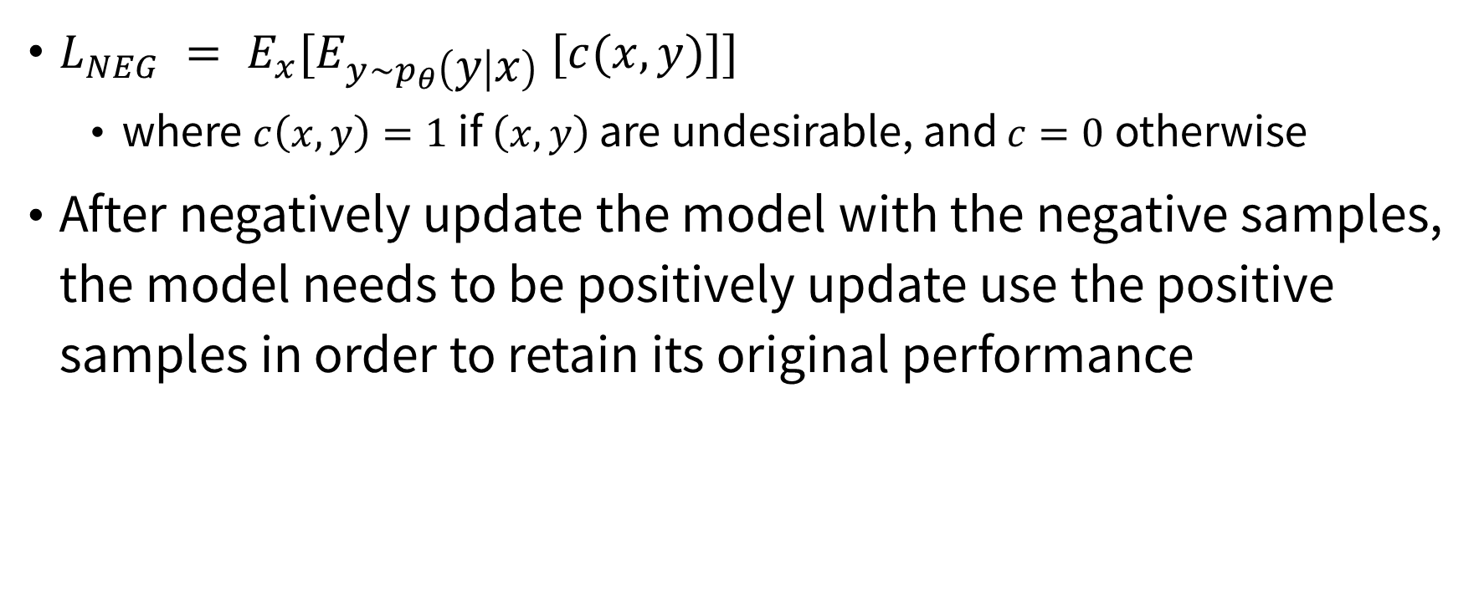
Method
Back to Outline
$L_{NEG} = E_{x}[E_{y\sim p_{θ}\left(y | x\right)} [c(x, y)]]$
where $c\left(x,y\right)=1$ if $\left(x,y\right)$ are undesirable, and $c=0$ otherwise
After negatively update the model with the negative samples, the model needs to be positively update use the positive samples in order to retain its original performance

Slide 7
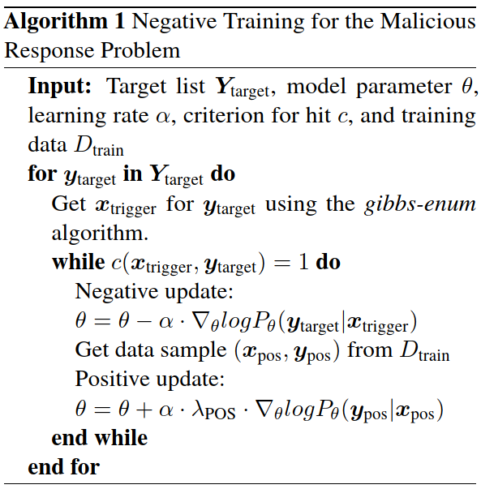
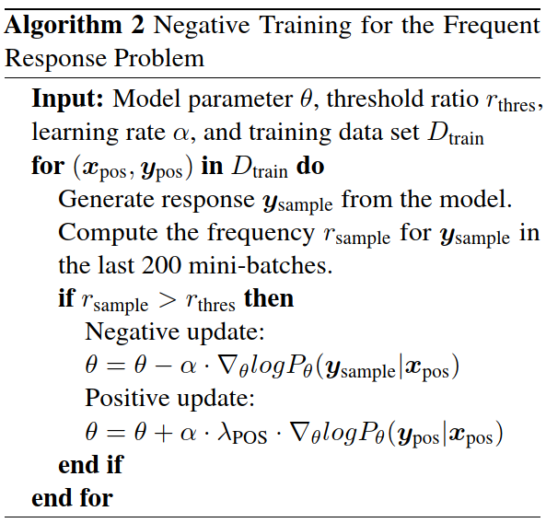
Method
Back to Outline

Slide 8
Experiment
Back to Outline
Metrics:
malicious hit-rate
max-ratio (of the most frequent response)
PPL
n-gram entropy (for diversity)

Slide 9
Experiment
Back to Outline
Results:
The hit rates of malicious responses drop after applying negative training. (Table 3)
Max-ratios also drop
Diversity does not necessarily lead to improvement on the informativeness of the response w.r.t. the input
Sample quality will decrease (becoming too long or ungrammatical) when threshold is too small

Slide 10
Conclusion
Back to Outline
Negative training can help correct undesirable behaviours

